Slide 1

Online Workshop on ‘Applications of Python programming in Data analytics and Machine Learning – Research Perspective’
15.6.20 Day 1 session 1
Dr. Sm. Badhusha
Professor/ CSE department
Alva’s Institute Engineering and Technology
Mijar, Moodbidri, Mangalore

Slide 2
Basics of
Python Programming

Slide 3
Objectives of the Day 1 session 1
To acquire knowledge in basic programming constructs in Python
To comprehend the concept of functions in Python
To practice the simple problems in programming constructs and functions in Python

Slide 4
Introduction to Python
Python - a general-purpose,Interpreted, interactive, object-oriented and high-level programming language.
Fastest growing open source Programming language
Dynamically typed
Versatile and can be adapted in DA, ML,GUI,Software &Web development
It was created by Guido van Rossum during 1985-1990.

Slide 5
Python IDEs
IDLE
Pycharm
Spyder
Thonny
Atom
Anaconda -Jupyter Notebook, Ipython for larger project in different domains.
Google colab

Slide 6
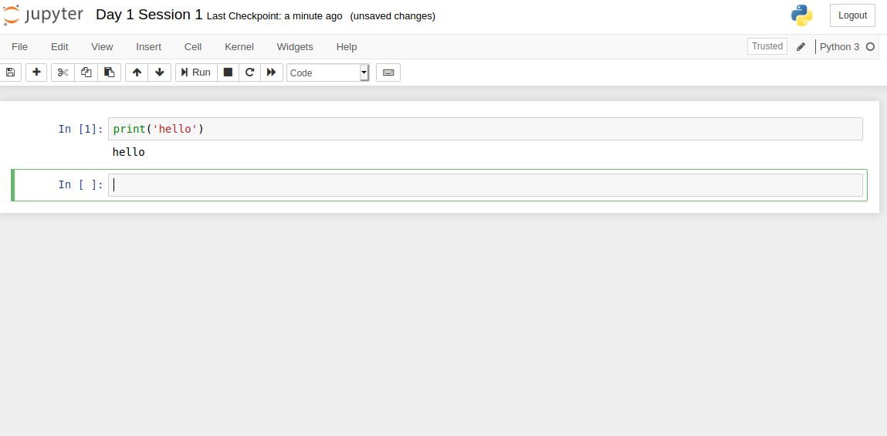
Anaconda activated Jupyter notebook/google colab

Slide 7
Comment lines
Single comment line is # comment line
Multiple comment lines triple single quotes or triple double quotes ‘’’ or “””
‘’’ multiple comment lines
……
…. ‘’’
  “““ This is the Program for blah blah blah.- multiple comment line”””
# This is a program for adding 2 nos

Slide 8
Multiple Assignment
You can also assign to multiple names at the same time.
>>> x, y = 2, 3
>>> x
2
>>> y
3
Swapping assignment in Python
x,y=y,x

Slide 9
Reserved Words
(these words can’t be used as varibles)
and | exec | Not
as | finally | or
assert | for | pass
break | from | print
class | global | raise
continue | if | return
def | import | try
del | in | while
elif | is | with
else | lambda | yield

Slide 10
Indentation and Blocks
  Python doesn't use braces({}) to indicate blocks of code for class and function definitions or flow control.
  Blocks of code are denoted by line indentation, which is rigidly enforced.
  All statements within the block must be indented the same level

Slide 11
Python uses white space and indents to denote blocks of code
Lines of code that begin a block end in a colon:
Lines within the code block are indented at the same level
To end a code block, remove the indentation

Slide 12
Python data types
Dynamically Typed: Python determines the data types of variable bindings in a program automatically.
But Python’s not casual about types, it
enforces the types of objects.
“Strong Typed”
So, for example, you can’t just append an integer to a string. You must first convert the integer to a string itself.
x = “the answer is ” # Decides x is bound to a string.
y = 23 # Decides y is bound to an integer.
print x + y # Python will complain about this.

Slide 13
Conditional Execution
if and else
  if v == c:
  #do something based on the condition
  else:
  #do something based on v != c
elif allows for additional branching
  if condition:
  elif another condition:
  …
  else: #none of the above

Slide 14
# python program for finding greater of two numbers
a=int(input(‘Enter the first number’))
b=int(input(‘Enter the first number’))
if a>b:
print("The greater number is",a)
else:
print("The greater number is",b)
# for satisfying equality condition
if a>b:
print("The greater number is",a)
elif a==b:
print(“both numbers are equal",a)
else:
print(“The greater number is",b)

Slide 15
Nested conditionals
One conditional can also be nested within another. We could have written the three-branch example like this:
a=int(input(‘Enter the first number’))
b=int(input(‘Enter the first number’))
if a==b:
print(“Both the numbers are equal",a)
else:
if a>b:
print(“The greater number is",a)
else:
print(“The greater number is",b)

Slide 16
Variables, expressions, and statements
python
>>> print(4)
4
If you are not sure what type a value has, the interpreter can tell you.
>>> type('Hello, World!')
<class 'str'>
>>> type(17)
<class 'int'>
>>> type(3.2)
<class 'float'>
>>> type('17')
<class 'str'>
>>> type('3.2')
<class 'str'>

Slide 17
If you give a variable an illegal name, you get a syntax error:
>>> 76trombones = 'big parade'
SyntaxError: invalid syntax
>>> more@ = 1000000
SyntaxError: invalid syntax
>>> class = 'Advanced Theoretical Zymurgy'
SyntaxError: invalid syntax

Slide 18
Operators and operands
a=20 b=10
+ Addition Adds values on either side of the operator.
a + b = 30
- Subtraction Subtracts right hand operand from left hand operand.
a – b = -10
* Multiplication Multiplies values on either side of the operator
a * b = 200
/ Division Divides left hand operand by right hand operand
b / a = 2.0

Slide 19
// Floor Division - The division of operands where the result is the quotient in which the digits after the decimal point are removed.
9//2 = 4 and 9.0//2.0 = 4.0
% Modulus Divides left hand operand by right hand operand and returns remainder
b % a = 0
** Exponent Performs exponential power calculation on operators
a**b =10 to the power 20

Slide 20
Relational Operators
== equal to
!= or <> not equal to
> greater than
>=greater than or equal to
< less than
<= less than or equal to

Slide 21
Python Assignment Operators
= Assigns values from right side operands
to left side operand c = a + b assigns value of a + b into c
+= Add AND It adds right operand to the left operand
and assign the result to left operand
c += a is equivalent to c = c + a
-= Subtract AND It subtracts right operand from the left
operand and assign the result to left operand c -= a is equivalent to c = c – a
*= Multiply AND It multiplies right operand with the left
operand and assign the result to left operand c *= a is equivalent to c = c * a

Slide 22
/= Divide AND It divides left operand with the right operand and assign the result to left operand c /= a is equivalent to c = c / ac /= a is
equivalent to c = c / a
%= Modulus AND It takes modulus using two operands and assign the result to left operand c %= a is equivalent to c = c % a
**= Exponent Performs exponential power calculation on
operators and assign value to the left c **= a is equivalent to c = c ** a

Slide 23
The + operator works with strings, but it is not addition in the mathematical sense.
Instead it performs concatenation, which means joining the strings by linking them end to end. For example:
>>> first = 10
>>> second = 15
>>> print(first+second)
25
>>> first = '100'
>>> second = '150'
>>> print(first + second)
100150

Slide 24
Functions
A function is a block of organized, reusable code that is used to perform a single, related action.
Functions provide better modularity for your application and a high degree of code reusing.

Slide 25
Syntax for function definition
def functionname( parameters ):
function_suite
return [expression]
Example :
def great2(x,y) :
if x > y :
return x
else:
return y
Special feature of function in Python is that it can return more than one value

Slide 26
Calling the Function
def great2(x,y) :
if x > y :
return x
else:
return y
a=int(input(‘Enter a’))
b=int(input(‘Enter b’))
print(‘The greater number is’, great2(a,b))

Slide 27
Catching exceptions using try and except
inp = input('Enter Fahrenheit Temperature:')
try:
fahr = float(inp)
cel = (fahr - 32.0) * 5.0 / 9.0
print(cel)
except:
print('Please enter a valid number')

Slide 28
Concluding Tips
Interpreted ,Object oriented and open sourced Programming language
Developed by Guido van Rossum during 1985-90
Dynamically typed but strongly typed language
Indented language which has no block level symbols {}
No ; is necessary . Block beginning starts with :
function starts with def key word followed by function name and :
#- single comment line ’’’ - multiple comment line
if...else if...elif ...elif No endif
Multiple assignment x,y,z=2,4,5 is possible
/ - divide with precision //- floor division (no precision)

